Slide 1
adj
adjectif
the best
the worst

Slide 2
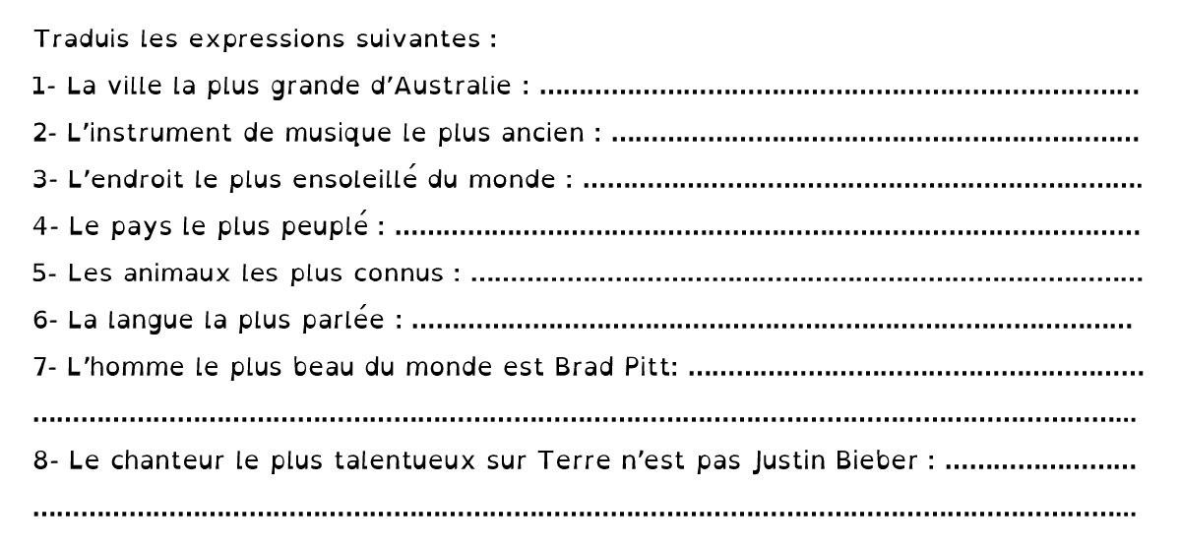
CORRECTION
The biggest city in Australia.
2. The most ancient / the oldest instrument
3. The sunniest place in the world
4. The most populated country
5. The most famous animals
6. The most broadly-spoken language
7. The most beautiful man in the world is Brad Pitt
8.The most talented singer on Earth is NOT Justin Bieber...

