Slide 2
FINAL TASK
APPLY TO BRITAIN’S GOT TALENT BY VIDEO!
Prepare your application. Take some notes! You can use your copybook.
You must :
- Be polite ! (Say Hello…)
Present yourself (name, age, city, origins and nationality, family, pets,…)
Talk about your personality,
Talk about your favourite activities
What job will you do in the future?
Present your talent(s) (I can… extremely well!)
- Do you think you will win the competition? Explain why.
Now, memorise and practise: you must be convincing!

Slide 3
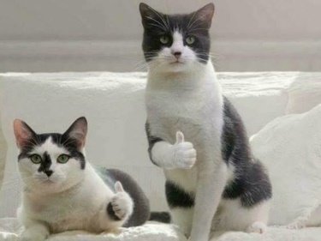
Homework for Thursday 17th:
At home, shoot your 1 or 2 minute video.
Don’t read your presentation, don’t be shy ! Be out-going and cheerful !
Film some illustrations to your presentation, be original !
Show your talent, for 20 or 30 seconds at the end!
Send me the video via laclasse.com or put it on a USB key.

